Slide 1


CSE 299 project the food app
Sakib Mahmud
Fatema Tuz Zohra

Slide 2

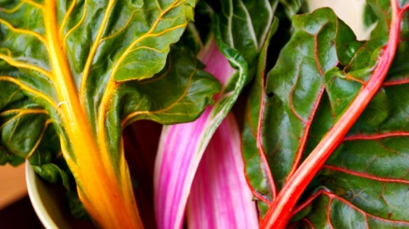

Select from a bunch of recipes
Local
Fresh
delicious

Slide 3

Choose according to your preference
spicy
calories
Cooking time
Prep time
Level of expertise

Slide 4
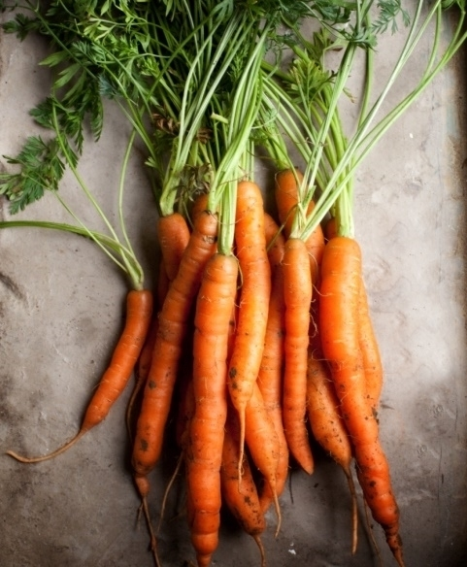
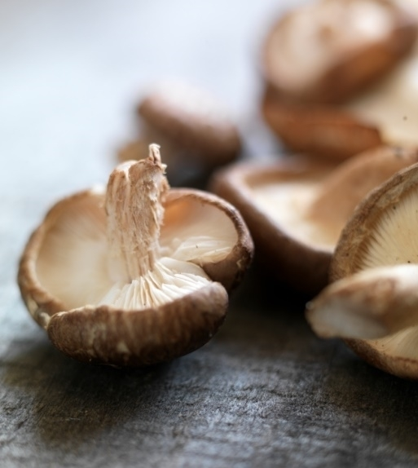

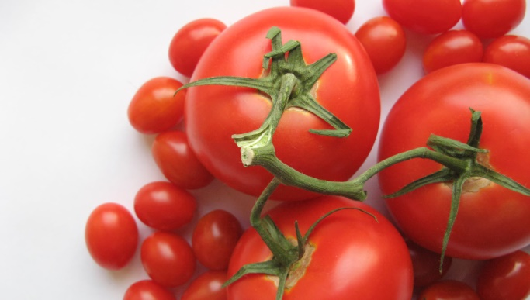
Our process
Select the ingredients and search
and enjoy your meal
Find what you want to cook

Slide 5
Thank you

